Slide 1
Coal for Power Sector
Arun Srivastava
6th Sept 2016
6th Coal Summit & Expo

Slide 2
Coal Basic Facts
Third largest hard coal reserves in the world (12% of the world total) (as per IEA – India Energy Outlook 2015)
301 BT of geological reserves of coal (@ 1200 m as on 01.0.4.2014)
R/P of 126 years (considering 1BTPA)
Proven Reserves | Indicated Reserves | Inferred Reserves
126 BT | 142 BT | 33 BT
Nearly 78% of the coal produced gets consumed in Power Sector
Addition in Coal Resources during 2009 to 2014 (MoC)

Slide 3
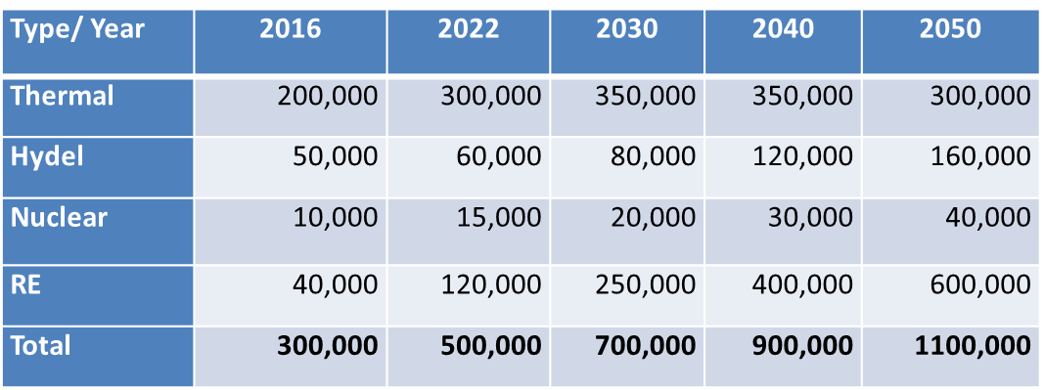
Power Basic Facts
303,083 MW of installed capacity as of 31.05.2016,
186,243 MW is coal based (61% of total installed capacity).
~85% of annual power generation is from thermal
Coal would remain critical to the economy but there would be alternatives.
Existing and Expected Capacity in MW
Source: Industry Estimate

Slide 4
But Things Are Changing . . . .

Slide 5
Drivers of Change
Changes are due to factors quite external to the coal industry and include:
Environmental factors
The impact of Carbon Emission / GHG etc. are beyond debate
The time has come to ACT
The environmental impact mitigation will be a global agenda and despite local compulsions the inevitable might only be slightly deferred but not stopped
Unless disruptive technological break-through is achieved
Availability of Technology Based Alternatives
The Renewables are here to stay and capture the energy space
With more technological advancement and solarization drive catching up momentum the energy landscape will change
Taking the shape of a Mass Movement soon

Slide 6
What Are These Changes
Dependence on coal as energy resource is reducing
Relationship between the coal and user industries getting redefined
It will cease to be a sellers market
Coal industry would need its customers more than ever before
The issue now is not “FOR HOW LONG THE COAL RESERVES WILL LAST” it is “FOR HOW LONG CAN WE USE COAL AND HOW”?
The basic nature of operation of coal based power plants will undergo fundamental and profound change
Coal based generation capacity would not longer be for “Base Load” operations
They would soon become “Support Capacities” for Renewables – to be used on need basis
While coal based generation would continue to have crucial redefined role the Renewables would be the Predominant Players
COMPETITION IS NOT WITH OTHER PLAYER IT IS WITH TECHNOLOGY

Slide 7
Only Technology Can Compete With Technology

Slide 8
The Implications
It will cease to be a sellers market
The coal industry would rather need to reinvent itself to have a market and to create sustainable relevance for itself
In terms of coal as a product, the industry would need to offer what the buyer needs
Both in terms of coal specifications and quality
More importantly, it would need to offer new products and get into new service offerings
The new offerings could include liquefied / gasified coal
It could include carbon capture / sequestration
It should essentially be far more environment friendly – both in extraction and end use
A new Energy Map would need to be drawn with coal mine as fulcrum and electricity generators at the periphery in close proximity, sans transportation

Slide 9
The Way Forward
Coal industry will need to offer energy in non-solid forms
Technological innovation would be needed to extract heat from the underground not necessarily coal
Jharia may need to be re-visited
Controlled Jharias may need to be created, going forward
Coal industry would need to gear up to deal with the environmental mess post usage
GIVEN THE WAY THE INDIGENOUS COAL INDUSTRY HAS RESPONDED TO THE COAL CRISIS IN THE PAST COUPLE OF YEARS. THERE IS LITTLE DOUBT THAT IT WOULD DEAL WITH THE CHALLENGES AND COME OUT WITH FLYING COLOURS

Slide 10
Website: www.tatapower.com
Email ID: arun.srivastava@tatapower.com
Contact No: (9811009211)

